Slide 1

Face Recognition

Slide 2


Supervised Technique
Labeled Data
Unknown face
Known face

Slide 3



Process
Features database
Labeled Data
(Known face)
Face detection
Face Recognition
Unknown face

Slide 4
How its work
Face
Detection
Recognition
Where is the face
This is person’s face

Slide 5




Detection
Preprocessing
Classification
Feature extraction
Post-processing

Slide 6
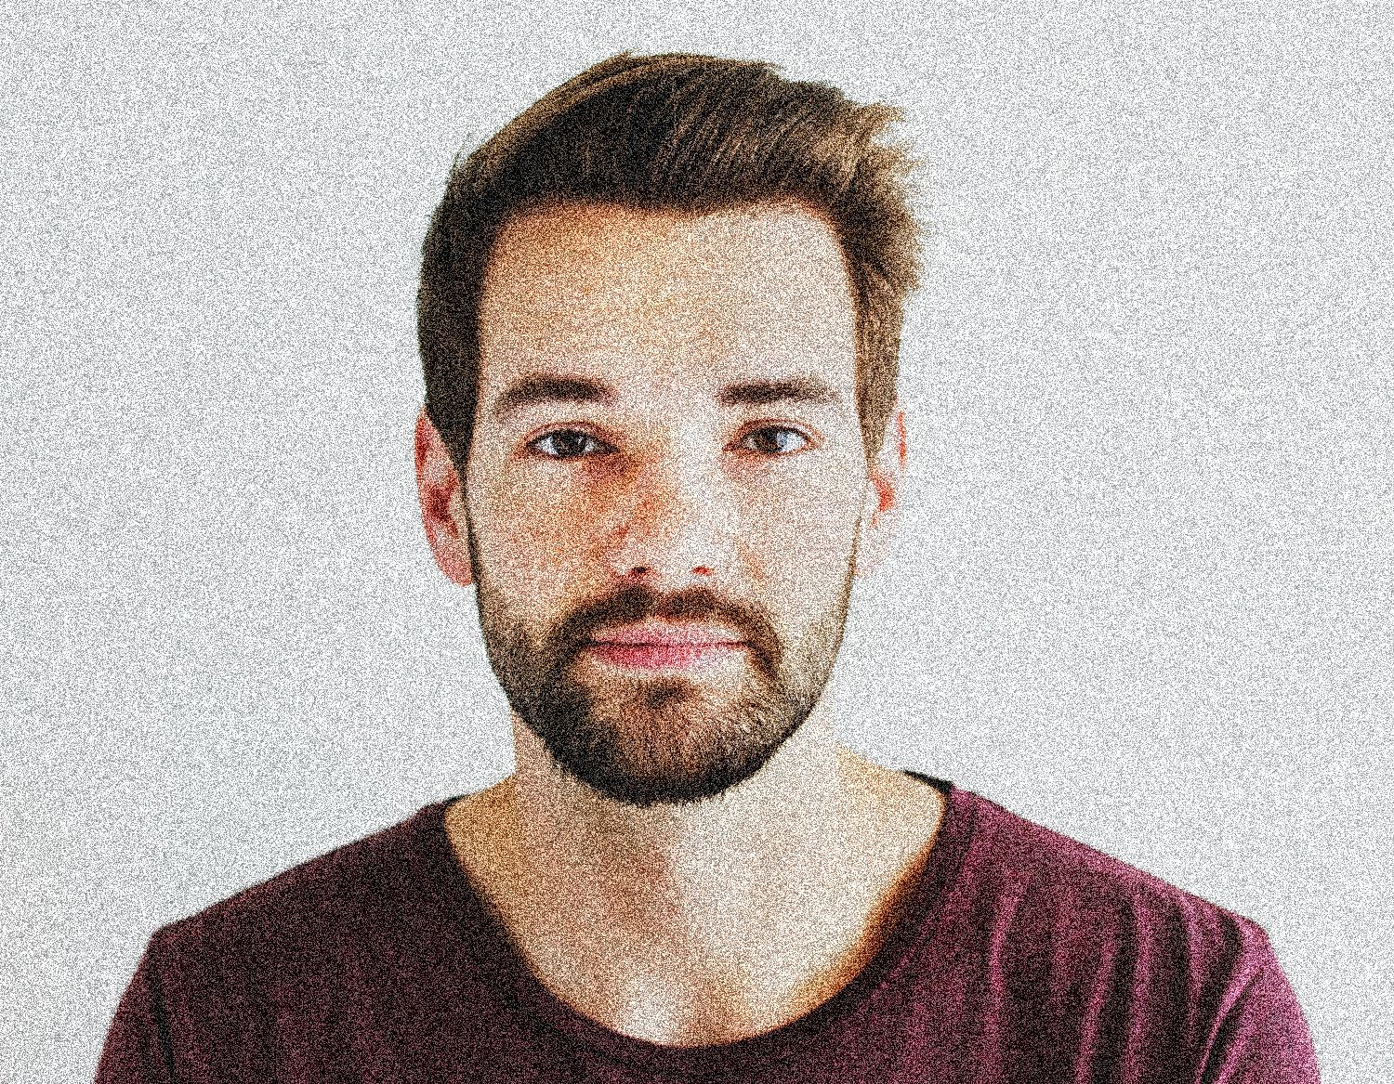
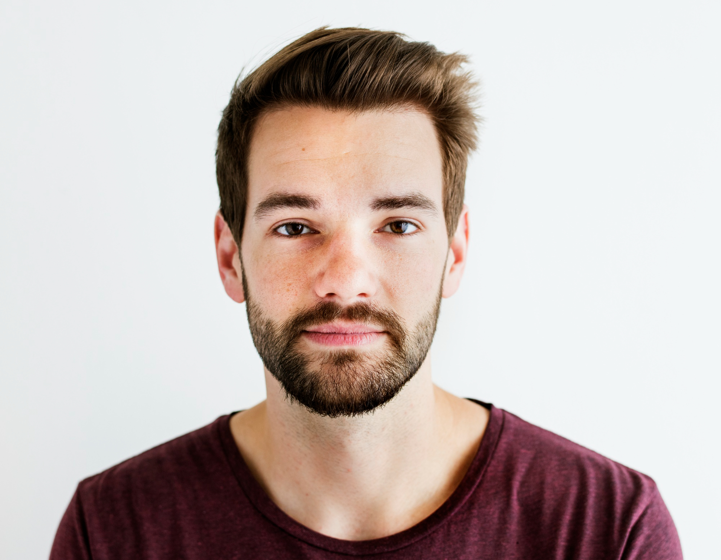

Preprocessing
In this step, the image is pre-processed to enhance its quality and reduce noise.

Slide 7
Preprocessing
How it works
applying a mathematical function called a filter to the image pixels to modify their values.
linear filtering

Slide 8
Feature extraction
The next step involves extracting features from the image that are characteristic of a face.
Left Eye
Right Eye
Nose
Mouth

Slide 9

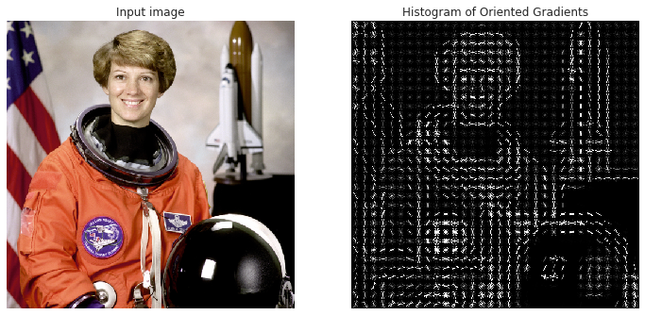
HOG Algorithm
(Histogram of Oriented Gradients)

Slide 10
HOG Algorithm

Slide 11
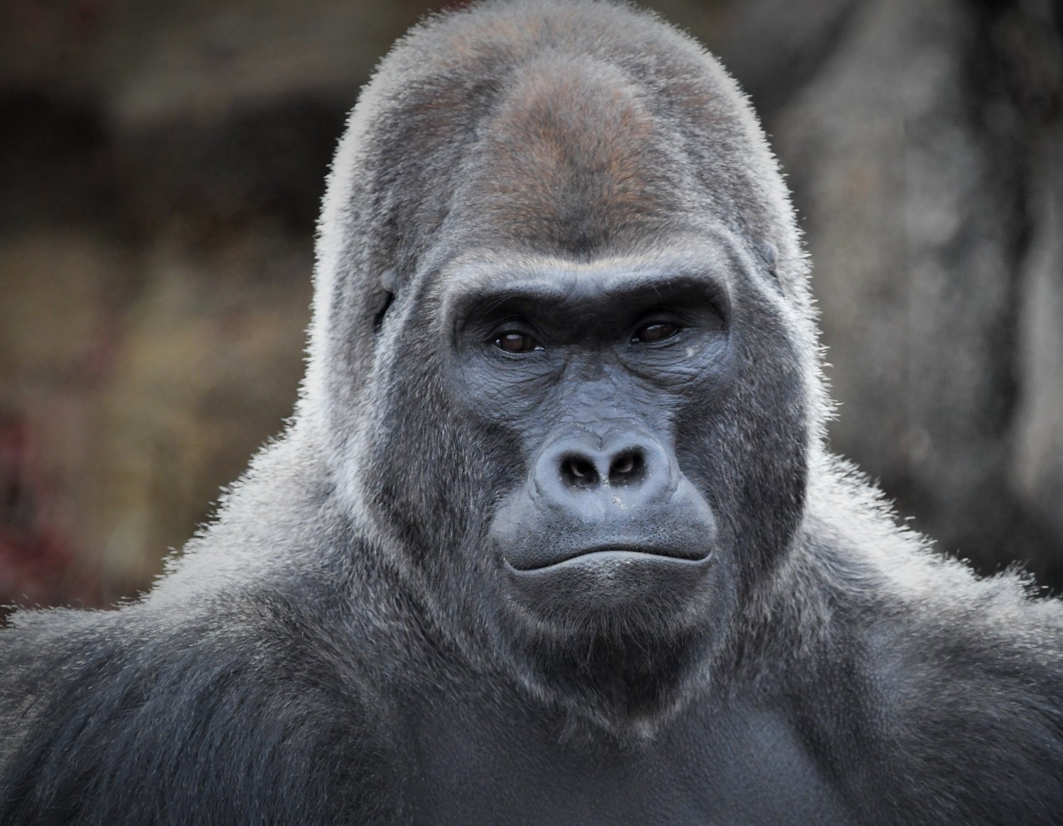

Classification
Once the features are extracted, a classifier is used to determine whether the image contains a face or not.

Slide 12



Classification
K-Nearest Neighbours (KNN)
Training set
Test set

Slide 13
distance between the eyes
shape of the nose or lips
Color and brightness of the skin

Slide 14
Once the features are extracted, a classifier is used to determine whether the image contains a face or not.
Classification
K-Nearest Neighbours (KNN)
Training set
Test set

Slide 15

Post processing
After detecting a face, post-processing techniques can be used to refine the detection and improve the accuracy.
face tracking
Include
pose estimation
facial expression recognition

Slide 16
How its work
Face
Detection
Recognition
Where is the face
This is person’s face

Slide 17
Supervised Technique
Labeled Data
Unknown face
Recognition
Known face

Slide 18

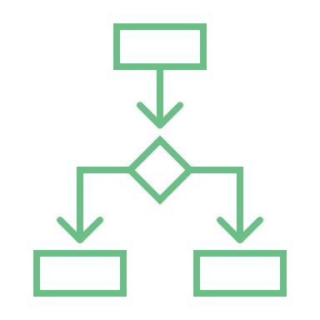
Recognition
Face matching
Decision making

Slide 19
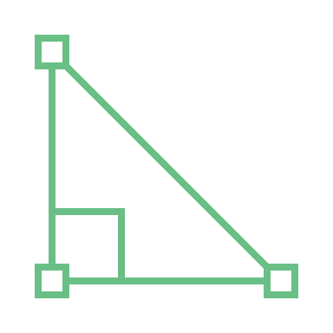
Face matching
The matching algorithm computes a similarity score between the detected face and the faces in the database.
Euclidean distance
known faces
detected face
Similarity Score
faces in the database

Slide 20
Decision making
determining whether the detected face matches any of the faces in the database
The decision is made based on
Similarity Score

Slide 21
How its work
Face
Detection
Recognition
Where is the face
This is person’s face

Slide 22



Implementation
Face Recognition library
Python

Slide 23
Team
Tarek Omar Gawesh طارق عمر جاويش
Asim Ahmed Gharib عاصم أحمد غريب
Muhammad Raafat Al-Bahi محمد رأفت البهي
Abdul Rahman Ali Al-Mawafi عبدالرحمن علي الموافي
Fadi Gamal Abdul Karim فادي جمال عبدالكريم

Slide 24
Thanks

